Slide 1
Gathering Data with APIs
R
Python gates, 2020

Slide 2
What is an API?
API: Application Programming Interface
Goal: To connect to a Server as a Client to gain data or information.
Common Method: POST/GET URL query with the correct key=value pairs.
Examples:
AirNow.gov
http://www.airnowapi.org/aq/forecast/latLong/?format=text/csv&latitude=39.0509&longitude=-121.4453&date=2020-08-04&distance=25&API_KEY=D9AA91E7-070D-4221-867C-EFF5E0D8C2C7
https://newsapi.org/
https://newsapi.org/v2/top-headlines?country=us&apiKey=8f4134f7d0de43b8b49f91e22100f22b

Slide 3
Which Sites/Companies Offer APIs?
The best method to answer this question is to search.
Some Examples:
https://docs.airnowapi.org/about
https://newsapi.org
https://developer.twitter.com/en/apply-for-access
https://www.mediawiki.org/wiki/API:Main_page
https://pypi.org/project/yahoo-finance/
https://finance.yahoo.com/quotes/API,Documentation/view/v1/
https://www.api-football.com/documentation
https://wonder.cdc.gov/wonder/help/WONDER-API.html
https://api.data.gov/docs/fbi/

Slide 4
Using an API – The Steps
1) Find the API you want to use.
2) READ the documentation ☺
3) Register and get the necessary keys, passcodes, etc.
EACH API is a little different – it is best to read the documentation and look at examples on the site
4) Be sure you know the endpoint URL (also called base URL).
5) Read about the attributes – the KEY = VALUE pair options.
6) Build a practice URL and test it.
7) Code it in R and Python

Slide 5
APIs and Building URLs in Python
## https://newsapi.org/
import requests
import json
BaseURL="https://newsapi.org/v1/articles"
URLPost = {'apiKey': '8f4134f7d0de43b8b49f91e22100f22b', ## USE YOUR KEY – NOT MINE!
'source': 'bbc-news',
'pageSize': 85,
'sortBy' : 'top',
'totalRequests': 75}
response1=requests.get(BaseURL, URLPost)
jsontxt = response1.json()
What does this build?
Try it!

Slide 6
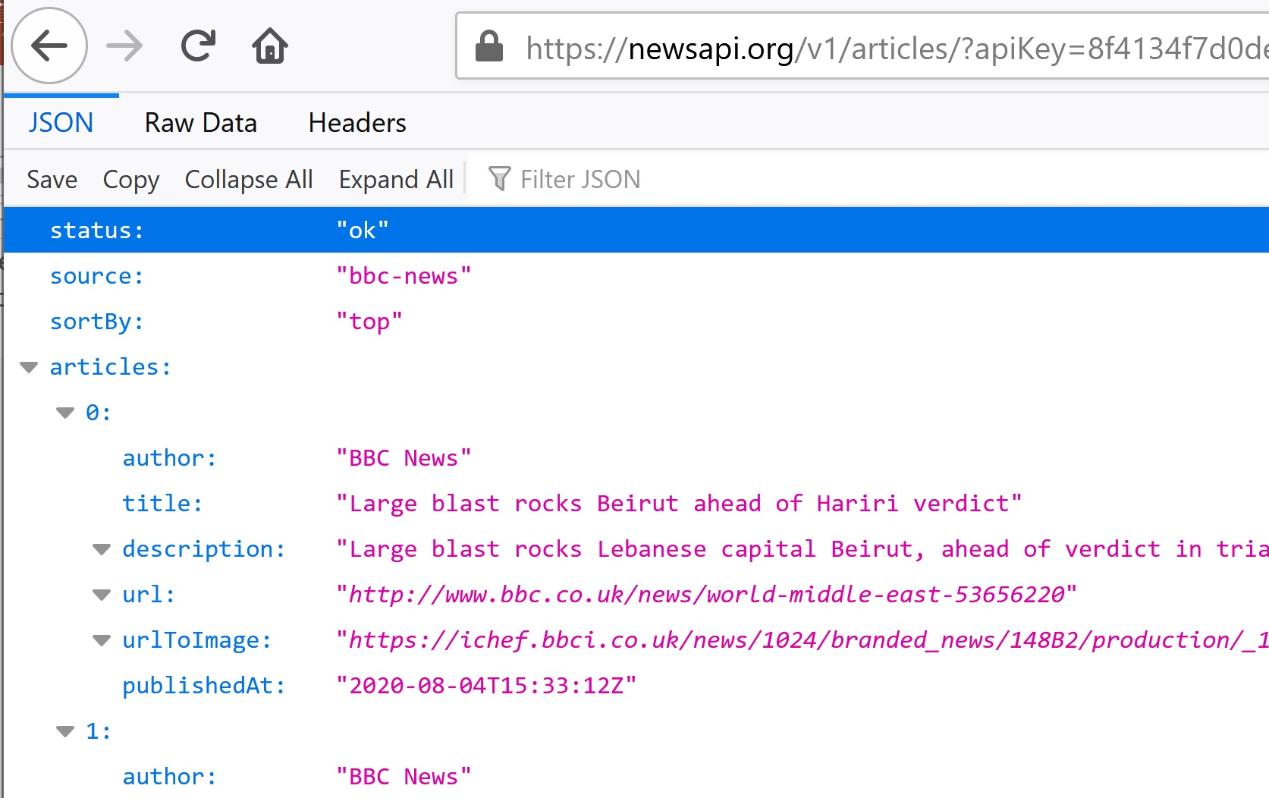
The URL Built by Python
https://newsapi.org/v1/articles/?apiKey=8f4134f7d0de43b8b49f91e22100f22b&source=bbc-news&pageSize=85&sortBy=top&totalRequests=75
Test it! How? Paste it into a Browser.
You should get this →

Slide 7
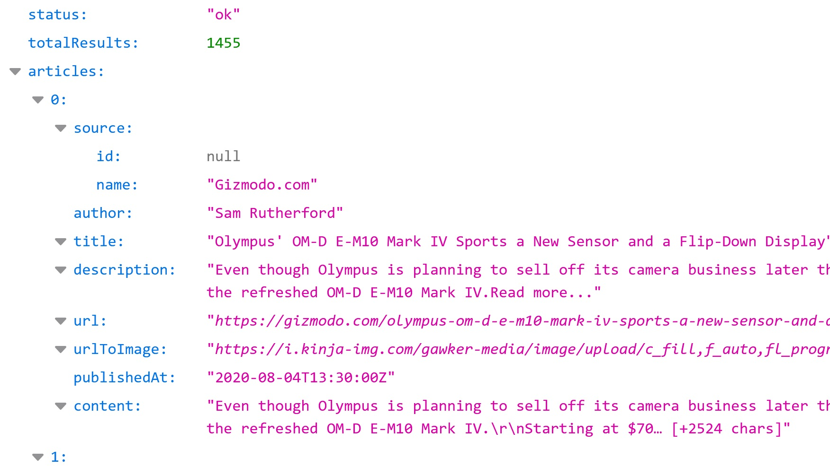
There are Many Ways To Do the Same Thing
### WAY 2
import requests
import json
url = ('https://newsapi.org/v2/everything?'
'q=Sports&'
'from=2020-08-04&'
'sortBy=relevance&'
'source=bbc-news&'
'pageSize=100&'
'apiKey=8f4134f7d0de43b8b49f91e22100f22b')
response2 = requests.get(url)
jsontxt2 = response2.json()
This code builds and posts THIS and returns the following
https://newsapi.org/v2/everything?q=Sports&from=2020-08-04&sortBy=relevance&source=bbc-news&pageSize=100&apiKey=8f4134f7d0de43b8b49f91e22100f22b

Slide 8
APIs and Building URLs in R
library("httr")
library("jsonlite")
base <- "http://www.airnowapi.org/aq/forecast/zipCode/"
FM<-"text/csv"
zipCode="20002"
date="2019-11-16“
## DO NOT USE MY KEY!!
API_KEY="D9AA91E7-070D-4221-867C-EFF5E0D8C2C7"
distance="25"
(call1 <- paste(base,"?",
"format", "=", FM, "&",
"zipCode", "=", zipCode, "&",
"date", "=", date,"&",
"API_KEY", "=", API_KEY, "&",
"distance", "=", distance,
sep=""))
(AirNowAPI_Call<-httr::GET(call1))
(MYDF<-httr::content(AirNowAPI_Call))

Slide 9
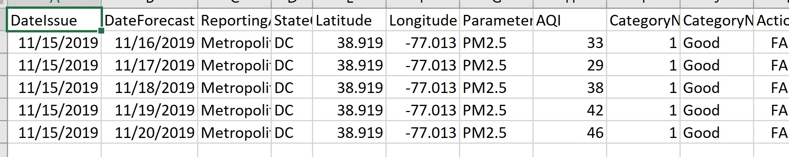
What Was Built - Posted – and Retrieved?
DO NOT USE MY API KEYS
This is the POST/GET URL that R Builds – try it in a Browser! What happens?
http://www.airnowapi.org/aq/forecast/zipCode/?format=text/csv&zipCode=20002&date=2019-11-16&API_KEY=D9AA91E7-070D-4221-867C-EFF5E0D8C2C7&distance=25
This is code to save the results of the query to a .csv file:
This is .csv file with the results:
AirName = "AirFileExample.csv"
## Start the file
AirFile <- file(AirName)
## Write to the file
write.csv(MYDF, AirFile, row.names = FALSE)

Slide 10
Links to APIs Code: Python and R
Python
https://drive.google.com/drive/folders/146La-4Nq_DRUdhY7bqJ0B5vlQkVd4iDl?usp=sharing
R
https://drive.google.com/drive/folders/17K0kgeNxiK8TWP-aMrepvgPxe2-hlcee?usp=sharing

Slide 11
Using the Twitter API
1) You will need a Twitter Dev Account. This can take time so get one now…
2) Use your .EDU email to apply for the Twitter Dev Account.
3) Learn to log into the Twitter Dev area and to get your codes and keys
4) Twitter does NOT make it easy. You will need to click, search, Google, explore, learn, and try.

Slide 12
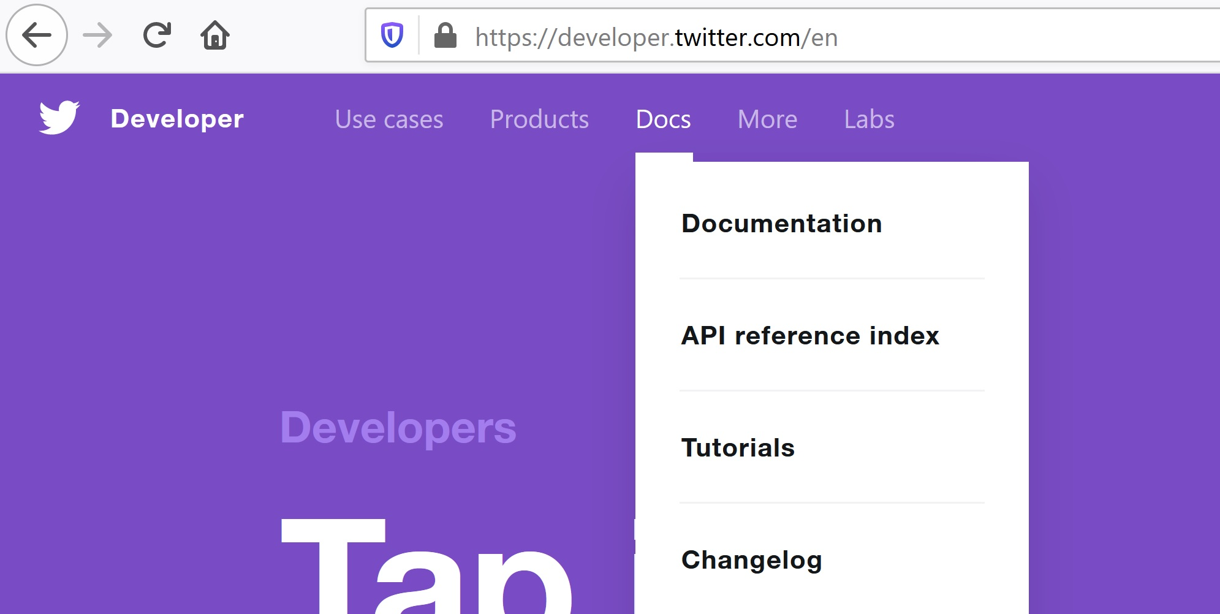

Slide 13
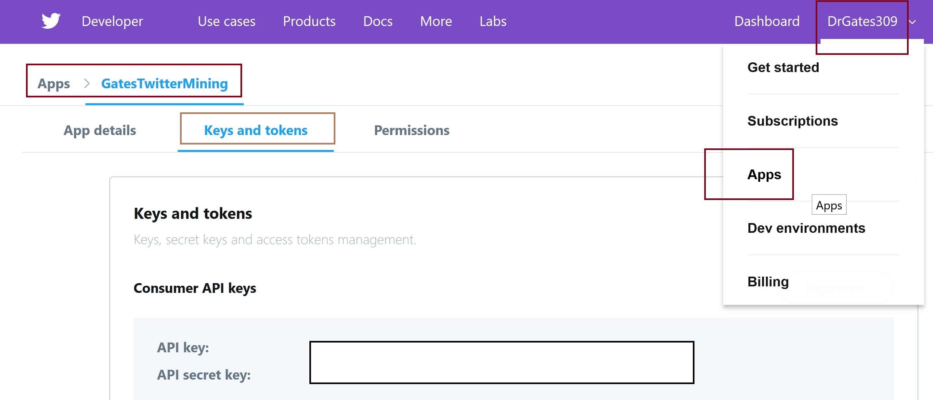

Slide 14
What is a REST API?
RE: https://dev.twitter.com/rest/public
“The REST APIs provide programmatic access to read and write Twitter data. “
You can: Create a new Tweet, read a user profile, follower data, and more.
The REST API identifies Twitter applications and users using OAuth; responses that are in JSON format.
If your intention is to monitor or process Tweets in real-time, consider using the Streaming API instead.”

Slide 15
What is “REST”
REST: Representational State Transfer.
An architecture style that is a stateless, client-server based, and cacheable communications protocol that generally works with HTTP.
A RESTful API refers to an application program interface (API) that uses HTTP and GET, PUT, POST, and DELETE; most commonly GET and POST.
Tutorial: http://www.restapitutorial.com/lessons/whatisrest.html
REST:
- Six Constraints: uniform interface, stateless, client-server, cacheable, layered, code on demand.
- Resourced-based (like user or address or thing) (rather than action based in SOAP-RPC such as get data).

Slide 16
What is OAuth: Send secure authorized requests
https://dev.twitter.com/oauth/overview/single-user
OAuth: Application-only authentication
Twitter offers the ability for you to retrieve a single access token (complete with oauth_token_secret) from application detail pages found on dev.twitter.com.
This is ideal for applications with single-user use cases. You shouldn’t ever share the combination of your OAuth consumer key, secret, access token, and access token secret.
By using a single access token, you don’t need to implement the entire OAuth token acquisition dance. Instead, you can pick up from the point where you are working with an access token to make signed requests for Twitter resources.

Slide 17
Twitter and OAuth Code in Python:
import tweepy
#conda install -c conda-forge tweepy
from tweepy import OAuthHandler
auth = OAuthHandler(consumer_key, consumer_secret)
auth.set_access_token(access_token, access_secret)
api = tweepy.API(auth)

Slide 18
Other Methods of Gathering Data
1) Experiments
2) Surveys (online, phone, in-person)
3) Downloading from Data Sites
Kaggle
CDC
.gov sites
Etc.
4) Web Scraping – this method is generally not permitted and it is always better to use an API.

Slide 19
